Slide 1
Use Case Diagrams
Use case diagrams are used to visualize, specify, construct, and document the behavior of the system, during requirements capture and analysis.
Use Case diagrams are used during analysis phase to identify and partition system functionality
They separate the system into actors and use cases
Actors represent role to be played by users of the system
A use case specifies the behavior of a system or a part of a system, and is a description of a set of sequences of actions
1

Slide 2
Use Case (Cont’d)
An actor is rendered as a stick figure in a use case diagram. Each actor participates in one or more use cases
Register for Courses
A use case is rendered as an ellipse in a use case diagram. A use case is always labeled with its name.

Slide 3
Use Case (Cont’d)
Actors can participate in a generalization relation with other actors.
Student
Person

Slide 4
Use Case (Cont’d)
Actors may be connected to use cases
only by associations.
Register for Courses
Student

Slide 5
Use Case (Cont’d)
Here we have a Student interacting with the Registrar and the
Billing System via a “Register for Courses” use case.
Billing System
Register for Courses
Student
Registrar

Slide 6
Example of Use Case Diagram
registration
updating
grades
student
faculty
output
generating

Slide 7
Class diagram
The UML class diagram is also known as object modeling. It is a static analysis diagram. These diagrams show the static structure of the model
The purpose of a class diagram is to depict the classes within a model. In an object oriented application, classes have attributes (member variables), operations (member functions) and relationships with other classes

Slide 8
Class diagram
Classes
A class is a description of a set of objects that share the same attributes, operations, relationships, and semantics.
Graphically, a class is rendered as a rectangle, usually including its name, attributes, and operations in separate, designated compartments.
ClassName
attributes
operations

Slide 9
Class Names
Class diagram
ClassName
The name of the class is the only required tag in the graphical representation of a class. It always appears in the top-most compartment.
attributes
operations

Slide 10
Class Attributes
Class diagram
Person
An attribute is a named property of a
class that describes the object being modeled.
In the class diagram, attributes appear in
the second compartment just below the
name-compartment
name : String
address : Address
birthdate : Date
ssn : Id
Attributes are usually listed in the form:
attributeName : Type

Slide 11
Class Operations
Class diagram
Person
name : String
address : Address
birthdate : Date
ssn : Id
Operations describe the class behavior
and appear in the third compartment.
eat()
sleep()
work()
play()

Slide 12
Relationships
In UML, object interconnections (logical or physical), are modeled as relationships.
There are three kinds of relationships in UML:
  - Dependencies
  - Generalizations
  - Associations

Slide 13
Dependency Relationships
A dependency indicates a semantic relationship between two or
more elements. The dependency from CourseSchedule to Course exists because Course is used in both the add and remove operations of CourseSchedule.
CourseSchedule
Course
add(c : Course)
remove(c : Course)
Software Design (UML)

Slide 14
Generalization Relationships
Person
A generalization connects a subclass
to its superclass. It denotes an
inheritance of attributes and behavior
from the superclass to the subclass
Student
Software Design (UML)

Slide 15
Generalization Relationships (Cont’d)
UML permits a class to inherit from multiple superclasses,
Student
Employee
TeachingAssistant
Software Design (UML)

Slide 16
Sequence Diagram
A sequence diagram is an interaction diagram that emphasizes the time ordering of messages. It shows a set of objects and the messages sent and received by those objects.
Graphically, a sequence diagram is a table that shows objects arranged along the X axis and messages, ordered in increasing time, along the Y axis.

Slide 17
Sequence Diagram
An object in a sequence diagram is rendered
as a box with a dashed line descending from it.
The line is called the object lifeline, and it
represents the existence of an object over a
period of time.

Slide 18
Sequence Diagram
an Order Line
a Stock Item
Messages are rendered as horizontal
arrows being passed from object to
object as time advances down the
object lifelines. Conditions ( such as
[check = “true”] ) indicate when a
message gets passed.
check()
[check = “true”]
remove()

Slide 19
Sequence Diagram
an Order Line
a Stock Item
check()
[check = “true”]
remove()
Notice that the bottom arrow is different. The arrow head is not solid, and there is no accompanying message.
This arrow indicates a return from a previous message, not a new message.

Slide 20
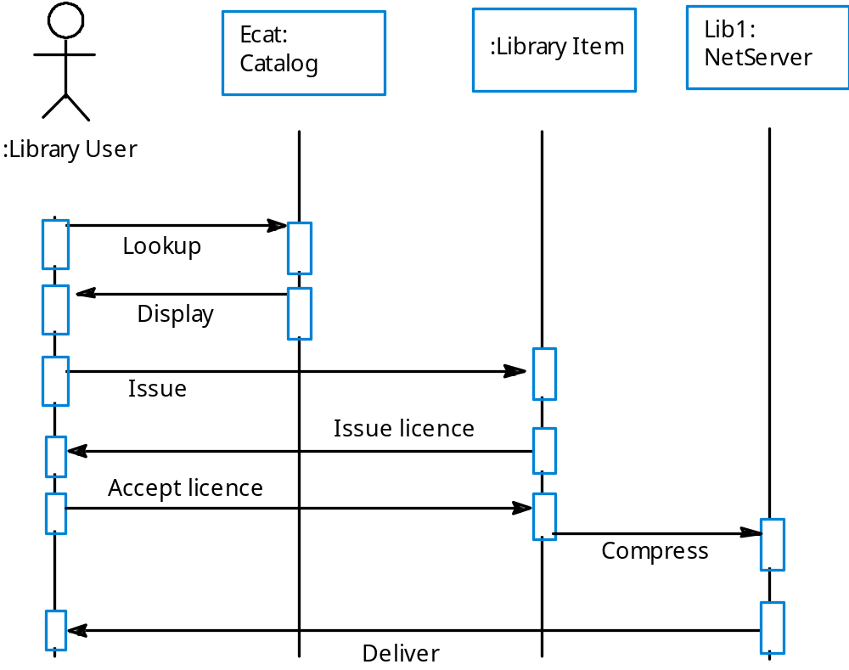
Issue of electronic items
Sequence Diagram

